Slide 1
WEEK 2 Linear Regression

Slide 2
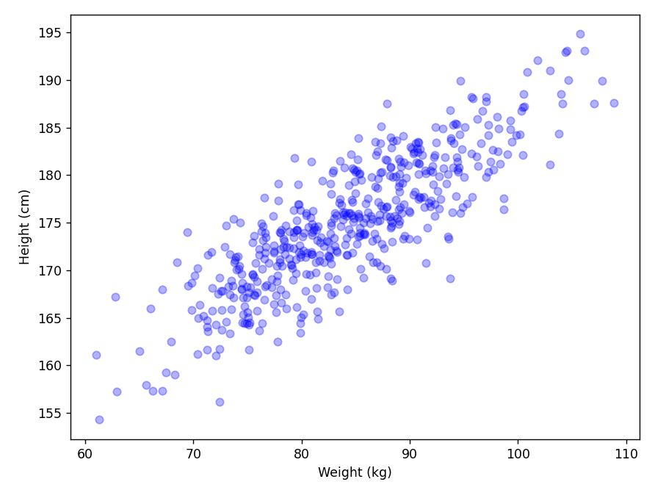
Fitting an Estimation Line to Data
To estimate Height by a given Weight:
A Continuous Function is needed

Slide 3
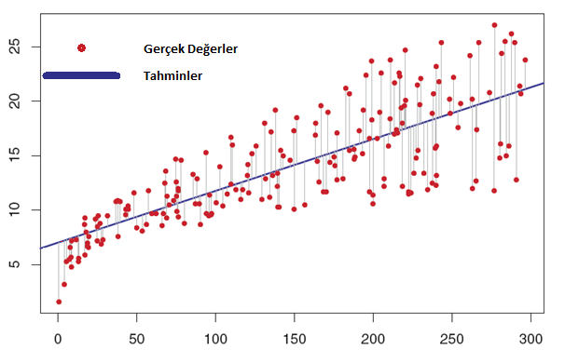
Linear Regression
Error = Sum of Vertical differences of predictions and real values

Slide 4
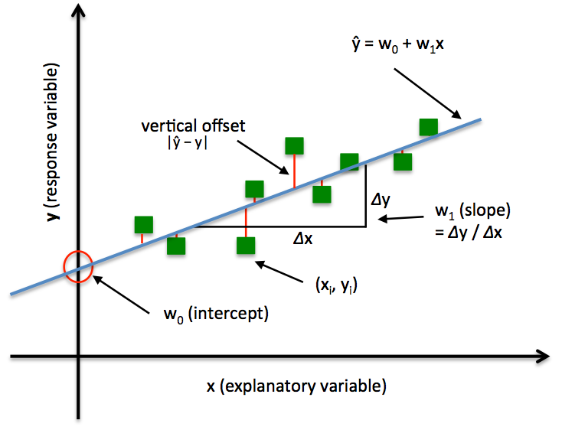
Line as a Function

Slide 5
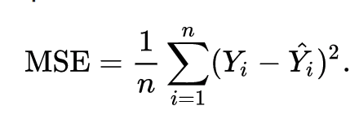
Mean Squared Error
True Value
Predicted Value

Slide 6
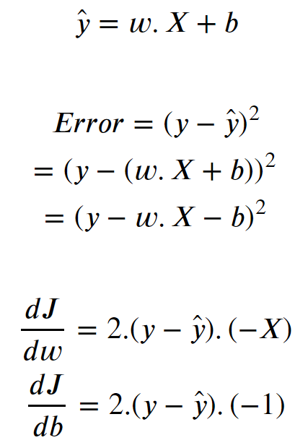
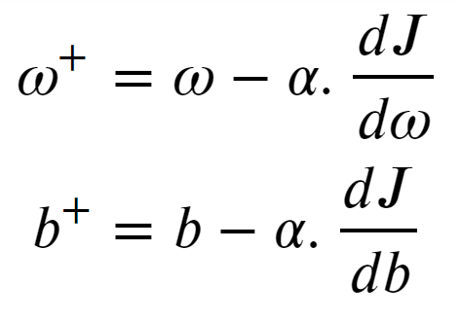
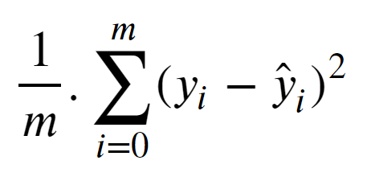
Gradients
Cost =

Slide 7
Learning Steps
Initialize W and b to a value
Do for some iterations (Learning phase):
Make predictions:
Update parameters and decrease error by using gradient descent:

Slide 8
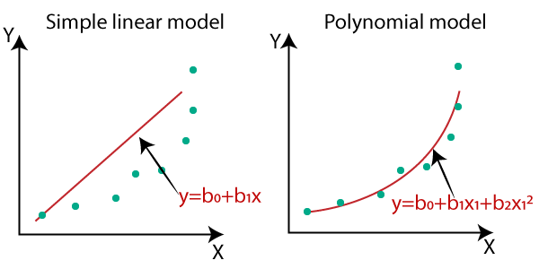
Polynomial Regression

Slide 9
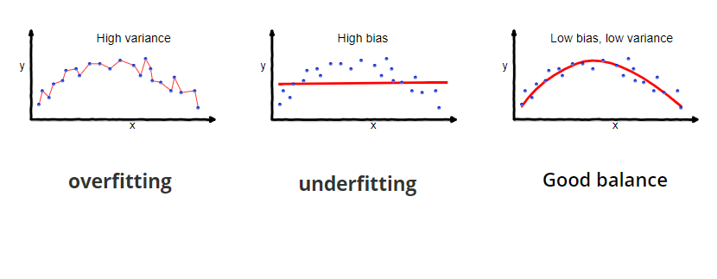
Bias and Variance
Fitting increases -> variance increases, bias decreases

Slide 10
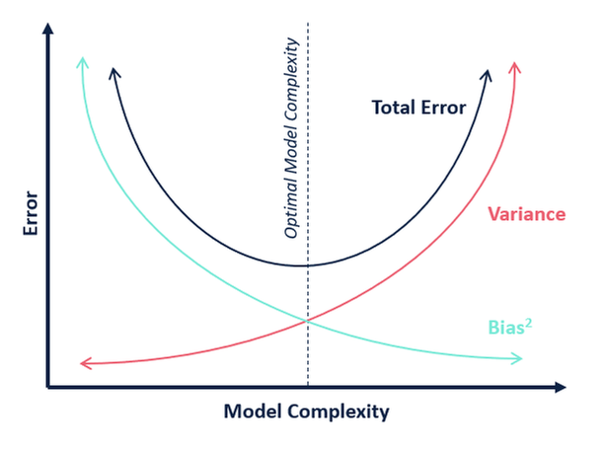
Biance-Variance Tradeoff

